Slide 1
Propagation Modes

Slide 2
Basics
When electrons move, they create electromagnetic waves that can propagate through the space.
Number of oscillations per second of an electromagnetic wave is called its frequency, f, measured in Hertz.
The distance between two consecutive maxima is called the wavelength, designated by λ.

Slide 3
Basics
By attaching an antenna of the appropriate size to an electrical circuit, the electromagnetic waves can be broadcast efficiently and received by a receiver some distance away.
In vacuum, all electromagnetic waves travel at the speed of light: c = 3x10⁸ m/sec.
In copper or fiber the speed slows down to about 2/3 of this value.
Relation between f, λ , c: λf = c

Slide 4
Basics
We have seen wireless channel concept earlier: it is characterized by a frequency band (called its bandwidth)
The amount of information a wireless channel can carry is related to its bandwidth
Most wireless transmission use narrow frequency band (Δf << f)
Δf: frequency band
f: middle frequency where transmission occurs
New technologies use spread spectrum techniques
A wider frequency band is used for transmission

Slide 5
Basics - Propagation
Radio waves are
Easy to generate
Can travel long distances
Can penetrate buildings
They are both used for indoor and outdoor communication
They are omni-directional: can travel in all directions
Properties of radio waves are frequency dependent
At low frequencies, they pass through obstacles well, but the power falls off sharply with distance from source
At high frequencies, they tend to travel in straight lines and bounce of obstacles (they can also be absorbed by rain)
They are subject to interference from other radio wave sources

Slide 6
Propagation Modes
Wireless transmissions propagate in three modes:
Ground Wave
Sky Wave
Line-of-Sight (LoS)

Slide 7
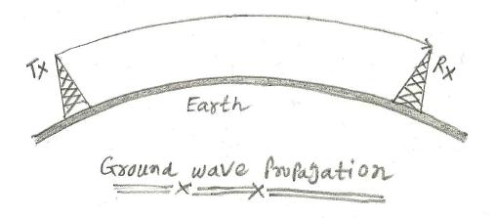
Contd.
Ground Wave
Ground wave propagation follows the contour/curvature of the earth, this is due to EM waves induce current in the earth's surface.
This causes wave-front to bend towards the earth and follow/propagate earth's surface.
Frequencies up to about 2MHz fall in this category of propagation.
Typical applications include AM radio broad-casting, direction finding, submarine communication, home control systems, analog telephone lines, long range navigation and more.

Slide 8
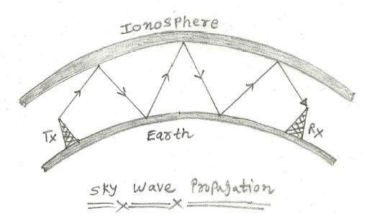
Contd.
Sky Wave
Sky wave propagation uses reflection by both earth and ionosphere.
Here ionosphere above earth's surface reflect the transmitted wave and hence it gets propagated due to reflection.
Frequencies between 2 MHz and 30 MHz fall in this category of propagation.
Typical applications include amateur radio, CB radio, international broad casting, military communication and long range aircraft/ship communication.

Slide 9
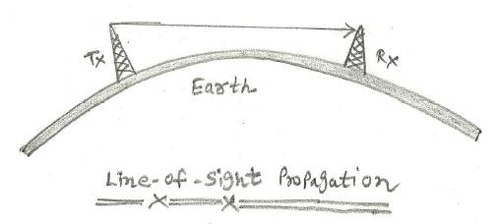
Contd.
Line-of-Sight (LoS)
The line of sight propagation requires the transmitting and receiving antennas to be within line of sight of each other.
Here signal above 30MHz are not reflected by ionosphere and here it is transmitted based on line-of-sight concept.
For satellite application, it is transmitted from earth station antenna to the satellite antenna.
For ground based wireless link, communication happens when both the transmit(Tx) and receive(Rx) antennas are in the line of sight of each other.
Frequencies above 30 MHz fall in this category of propagation.
Typical applications include VHF/UHF television, FM broad cast, optical communication, Infrared LANs, terrestrial wireless link, radar, cellular telecom, PCS, WLL and more.

Slide 10
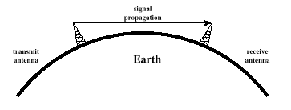
Line-of-Sight Propagation

Slide 11
Line-of-Sight Propagation
Transmitting and receiving antennas must be within line of sight
Satellite communication – signal above 30 MHz not reflected by ionosphere
Ground communication – antennas within effective line of site due to refraction
Refraction – bending of microwaves by the atmosphere
Velocity of electromagnetic wave is a function of the density of the medium
When wave changes medium, speed changes
Wave bends at the boundary between mediums

Slide 12
Line-of-Sight Equations
If h is the height of a transmitting (resp., receiving) antenna in meters, then the distance to the receiver (resp., transmitter) for line-of-sight transmission should be at most (Optical line of sight),
Since microwaves are bent or refracted by the atmosphere, the “effective" line of sight is, in fact, larger than the true line of sight. We introduce an adjustment factor K to capture the refraction effect and obtain,
d = distance between antenna and horizon (km)
h = antenna height (m)
K = adjustment factor to account for refraction, rule of thumb K = 4/3

Slide 13
Line-of-Sight Equations
Maximum distance between two antennas for LOS propagation:
h₁ = height of antenna one
h₂ = height of antenna two

Slide 14
LOS Wireless Transmission Impairments
Attenuation and attenuation distortion
Free space loss
Noise
Atmospheric absorption
Multipath
Refraction
Thermal noise

Slide 15
THE END

